Slide 1
SESSION #5:
NAMING & TAGLINE BRANDWORK

Slide 2
SESSION 5: WORKSHEETS
There are two parts to this lesson on verbal identity:
Creating a tagline (3 possible approaches)
Creating a brand name
You can do both of these parts or only one - it will depend on what your business needs

Slide 3
TAGLINE EXERCISES

Slide 4
SESSION #5: TAGLINES
Exercise: Taglines
There are two ways to create your taglines. I recommend you try both. Both of them build off of your Brand Framework (your one page strategy sheet).
#1 Take your Brand Idea and take out any unnecessary words and cut down to a short a phrase as possible. See Nike Example.
#2 Do the Tagline with a TWIST exercise. Pick 3 of your favorite taglines from other categories and then TWIST with your brand idea and pillars to create a tagline for your own business. We’ve listed some of the most popular all time taglines from Tagline Guru - but you should feel free to choose your own - which may not be on this list.
#3 Bonus Exercise: Brand Haiku. If you are having a difficult time capturing the essence of your Brand Idea and/or tagline in a few words, try the Haiku exercise.
See the following slides for tagline inspiration (you can also add your own) and an example from Hello Method.
When you have 3-5 taglines you are happy with from all of the exercises - put them on the Top Tag line worksheet (slide 11)

Slide 5
EXERCISE 1: JUST DO IT
TARGET INSIGHT
People know they should exercise more but have trouble committing to it
+
BRAND IDEA
We help you achieve your best so just get off the couch do some exercise you’ll feel better
+
EDITING
We help you achieve your best so JUST get off the couch DO some exercise (IT) you’ll feel better
=
POWERFUL TAGLINE
Just do it

Slide 6
EXERCISE #1: JUST DO IT
Write your Brand Promise below then cross out all the non-essential words until you can create the most concise version of your tagline.
Write your Brand Promise as a paragraph.
2) Cut down your Brand Promise until you can get it into one sentence/or a few words:

Slide 7
EXERCISE #2: TAGLINE TWIST
Hello Method Example
WHO (Bulls Eye Target):
Head of a school for a k-12 academy who is devoted to helping students work hard, dream big and thrive for a better future. He is marketing agnostic – he doesn’t value marketing a core tool to sharing his vision. But he is in desperate need of helping his school tell a stronger story so it can stand out and attract high quality faculty and engage current and future families to get involved.
WHAT (Brand Promise): Share Stories that Inspire
YOUR TOP 3 FAVORITE TAGLINES
TWIST WITH YOUR BRAND
1. Red Bull Gives You Wings.
2. Tastes Great. Less Filling.
3. Because I’m Worth It.
1. A Story Well Told Will Give You Wings.
2. Stronger Stories. Stronger Schools.
3. Because Your School Deserves a Stronger Story.

Slide 8
TOP 30 TAGLINES FOR INSPIRATION
Got milk?
Don’t leave home without it.
Just do it.
Where’s the beef?
You’re in good hands with Allstate.
Think different.
We try harder.
Tastes great, less filling.
Melts in your mouth, not in your hands.
Takes a licking and keeps on ticking.
When it absolutely, positively has to be there overnight.
A diamond is forever.
Finger-lickin’good!
The uncola.
Let your fingers do the walking.
There are some things that money can’t buy. For everything else there’s MasterCard. (Priceless)
What happens here, stays here.
You’ve come a long way, baby.
We bring good things to lif
The ultimate driving machine.
Pork, the other white meat.
Have a Coke and a smile.
I love New York.
Betcha can’t eat just one
The happiest place on earth.
Beef. It’s what’s for dinner.
Is it live or is it Memorex?
Because I’m worth it.
The few the proud, the marines.
Our repairmen are the loneliest guys in town.
SOURCE: TAGLINEGURU.COM

Slide 9
EXERCISE #2: TAGLINE TWIST
Worksheet
WHAT (Brand Promise):
YOUR TOP 3 FAVORITE TAGLINES
TWIST WITH YOUR BRAND
1.
2.
3.
1.
2.
3.

Slide 10
EXERCISE #3: BRAND HAIKU
Write your Brand Idea as a sentence:
2. Simplify your Idea and rewrite it as a Haiku (5/7/5 syllables):
3. Look at the Haiku and further edit into a tagline

Slide 11
YOUR TOP TAGLINES
Write the top 3-5 taglines you have created fro all the exercises below.
1.
2.
3.
4.
5.

Slide 12
NAMING EXERCISE

Slide 13
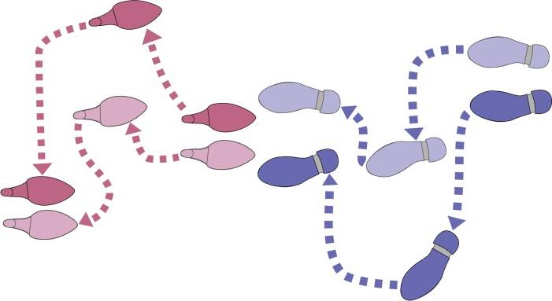
NAMING WITH A TWIST EXERCISE
To create a name for your business, pretend that you are naming a product in a different category that has the same benefits.
Step 1: Look in magazines cut out words
Step 2: Make a column of Key Words
Step 3: Brainstorm names for your business next to those words.
See our tips on turning words into names.
If you are also creating taglines you can try different combinations
‹#›

Slide 14
HOW TO TURN WORDS INTO NAMES
1. Combine words (ex. JetBlue, PetSmart)
2. Change spelling (ex. Orbitz, Google)
3. Look at metaphors/imagery
(ex. Simplicity = Apple, Range of choice = Amazon)
4. Create destinations (ex. AutoZone, Planet Fitness)
4. Use prefixes, suffixes, Latin roots
(ex. Verizon= truth + horizon, Vodafone = voice + data + telephone)
‹#›

Slide 15
NAMING WORKSHEET
Key Words
Names
‹#›

